Slide 1
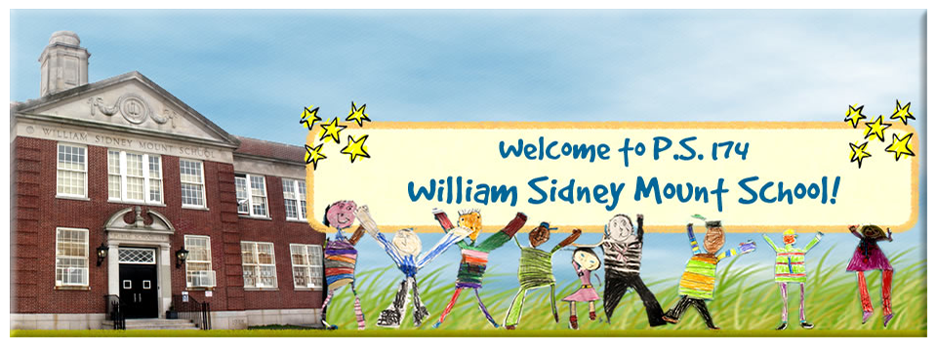
Blended Learning
Parent Information Session
Thursday, September 3, 2020

Slide 2
As we return to school, instruction for all of our students
needs to focus on these key elements:​
​
Knowing Students Well​
Integrate Academic and Social Emotional Learning​
Ensure Continuity of Learning​
Focus on Priority Learning

Slide 3
Public School 174 – September 2020
 | Monday | Tuesday | Wednesday | Thursday | Friday
6 Planning for Staff | 7 | 8 Teachers Return | 9 10 11 T e a c h e r P la n n i n g |  |  | The pattern will continue for subsequent months. All Cohorts A BC may change to D Remote group at any time. Changing from D Remote to Blended learning will only be offered for November return to Blended learning. *Holidays will be scheduled on NYC Calendar when public
13 All students Remote | 14 15 T e a c h e r P la n n i n g |  | 16 First Day All Students A B C D Remote | 17 A B C D Remote | 18 A B C D Remote
20 Rotation for Groups Begins | 21 Group A in person B C D Remote | 22 Group B in person A C D Remote | 23 Group A in person B C D Remote | 24 Group B in person A C D Remote | 25 Group C in person A B D Remote
27 Rotation for Groups | * Yom Kippur 28 Group B in person A C D Remote Yom Kippur * | 29 Group C in person A B D Remote | 30 Group A in person B C D Remote | October 1 Group B in person A C D Remote | October 2 Group C in person A B D Remote

Slide 4
How are arrivals and dismissals arranged?
School Hours 8:30am to 2pm
Health and Safety are our Priority
Visitor entry into the school building is limited and by appointment with Administration only.
Staff and students scheduled for the A B C day only.
Mask Compliance. Every person, staff, student,
visitor entering the school must wear a mask and have a temperature check.
Kindergarten-- Arrival / Dismissal Areas
K 105 K 101 Exit 7 - Ellwell Crescent—Little School Yard--Inner area
Grade 1 Exit 8 - Ellwell Crescent --Little School Yard –Behind Security
Grades 2 and 4 Exit 6 - Corner of 65th Drive and Dieterle Crescent (Flag)
Grade 3 and 5 Exit 2 – Dieterle Crescent – near Large School yard
Siblings may enter and dismiss together at entrance for the youngest sibling.
For dismissals, please send a note to the teacher.

Slide 5
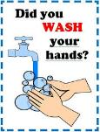
“In School Days” ​
How to prepare your child for being in school ​
​
Mask wearing.​
Prepare your child by wearing a mask at home– start with half hour, one hour and progress to 5 hours.​
Backpack Signage. Color coded for each day/group A B C
​
Social Distancing.​
Show your child what six feet looks like ----​
with a measuring tape or yarn/string 6 ft long,
or have your child walk the # of steps to equal 6 ft.​
​
Explain to your child the importance of not touching another child, their food or
books, pencils, and supplies. ​
​
Hand washing.​
“Clean hands keep us healthy!”
Practice handwashing at home,
using wipes before eating and afterwards.
Hand washing will be in classrooms before and after meals, as well as after restrooms.

Slide 6
I have other questions?
School Hours 8:30am to 2pm
Meals “Go Bags” --NYC offers Free Breakfast. Lunch “Go Bags” for every student.
Student meals are eaten at their desk during instruction and may be an outdoor “picnic” if available.
Recess/Outdoor As weather permits and social distancing of group; “PS 174 Outdoor Learning Plan” has been submitted to the NYC DOE for approval. Our small yard can accommodate groups in the PS 174 Learning Garden and grassy area. Children are
encouraged to bring a small towel or yoga mat (kept in the backpack) to use.
Transportation TBD - Office of Pupil Transportation based upon eligibility.
Parent Engagement Teacher time for parents daily from 2 pm – 2:20 pm
May be on the phone or through GoogleMeet

Slide 7
What will a school day look like in Blended Learning?
School day starts at 8:30AM and ends at 2:00PM.
Instructional lessons each day will include ELA, Math, Science or Social Studies. For Clusters: Music and Visual Art (Remote); PE and STEM (Remote and in Person)
Please visit our school website for learning objectives in each of these subjects: http://www.ps174.org
These lessons will be consistent whether in person or remote.
On days when your child is in school:
Breakfast, lunch, and snack will be in the classroom. Grab and Go Bags of breakfast and lunch will be provided. Lunch will be working in classroom or picnic style when appropriate.
There will be outdoor breaks and scheduled bathroom breaks throughout the day.

Slide 8
How much screen time should we expect?
Times are based on age and experience of learners and will expand as the months progress.

Slide 9
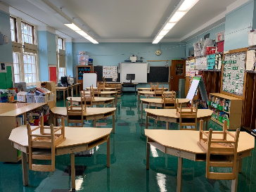
What will an in-person classroom look like?

Slide 10
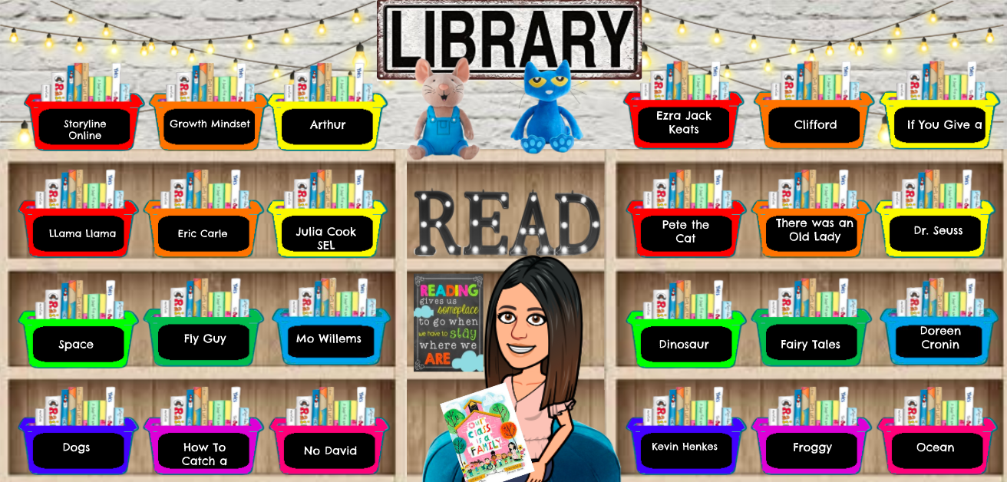
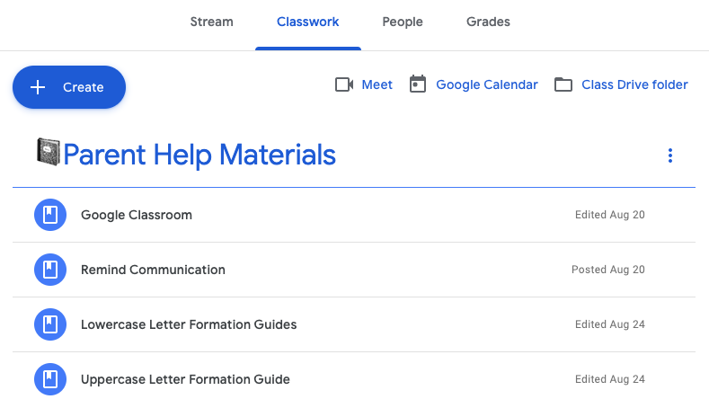
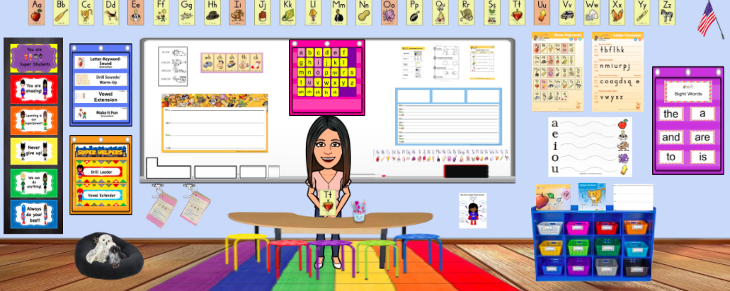
What will a remote Google classroom look like?

Slide 11
Group A, B, C ---
“At Home” Remote Days 2 to 4 days via Google Classrooms
Students are assigned Google logins
Daily schedule.
Live teaching. Student participation.
Recordings.
Parent Engagement – For teacher/ parent time
How to Prepare for “At Home” Learning—
Find a place/corner in the home—away from tv or distractions.
Try to create that routine.
Setup the laptop or ipad here.
Setup the study area with school supplies, pencils, paper, stickers, etc.
It’s Ok to- Take stretch breaks, crazy dance breaks, sing a song break!

Slide 12
How does our day begin on Remote Learning Days?
Flexible time during the day beginning with a morning Meeting
with the class on Google Classroom. All students are seen on the screen.
There will be time with scheduled (synchronous) learning and
off screen (asynchronous) learning for age specific times.
Synchronous – (live instruction)
Whole class, small group or individual students live instruction.
Content specific; or social emotional activities.
Individual feedback.
Scheduled in advance.
Asynchronous – Occurs daily and serves as supplemental work. Students are working on learning activities at their own pace at a flexible time.
Video lessons or recordings
Flipgrid
Discussion boards
Google slides; worksheets; written feedback on Google Classroom
iReady, Imagine Learning, Epic!, Read Me A Story; et al.

Slide 13
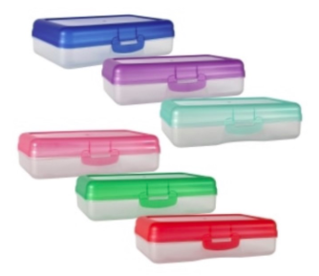
School Supplies
Supply List – no supplies are shared
“In School Days” bring the following in school bag--
Crayons
Markers
Pencils sharpened 6
Composition books 2
Folders (2 pocket) 2
Small box (to put pencils, scissors)
Book Bag (please no wheels)
Big enough to hold all of the above and sweater,
hats and brown bag lunch. All items are throw away.
*The top items will be kept in supply boxes (1 for school and 1 to keep at home). See below for supply boxes found at the Dollar Tree.*

Slide 14
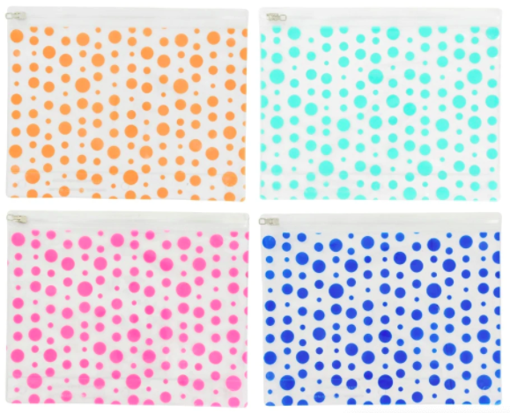
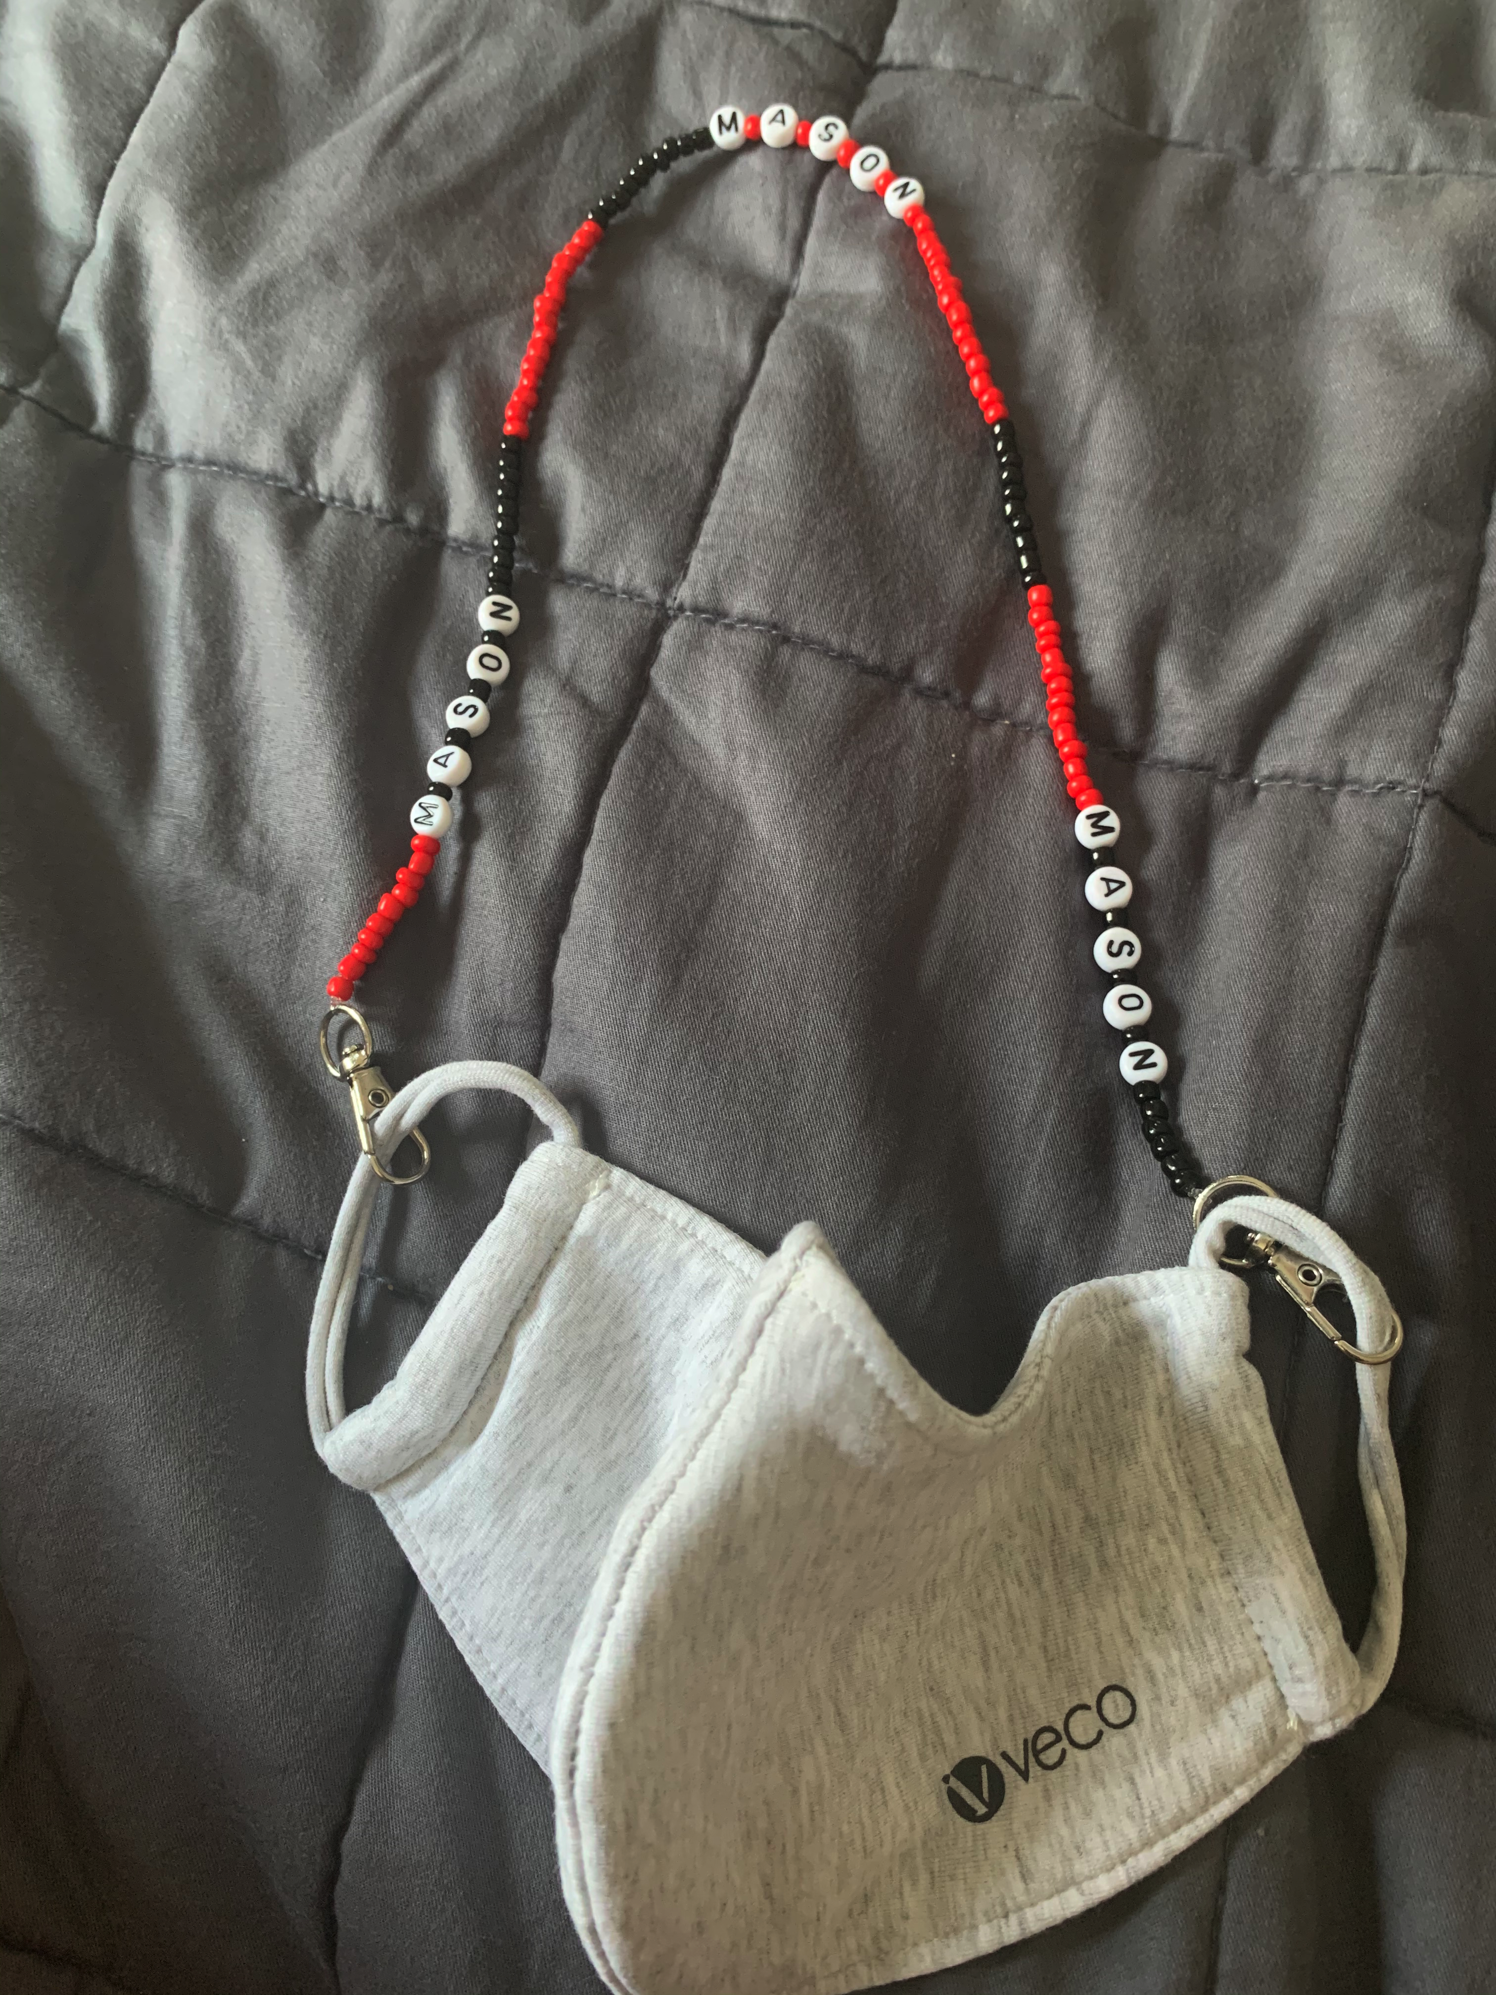
Items to Consider…
Extra masks, mask storage, and mask lanyard/chain (All items must be labeled and can be found at Dollar Tree).
Small hand sanitizers may be sent in and will be used under adult supervision.
Bring a labeled disposable water bottle and an extra disposable bottle for refills (or cups can be used).

Slide 15
You will be given instructions to join your child’s REMIND group the first week of school. It’s very important you join to get updates and notifications from Principal Kelly and your child’s teachers (both in-person and remote).
Separate remind groups for blended learning, remote learning, and bussing. Messages are set up for texts. Add your name and child’s
This is our form of communication at P.S. 174.

Slide 16
Questions?

